Slide 1
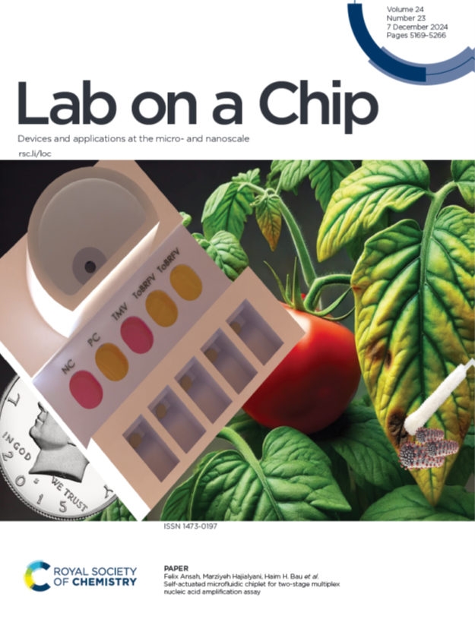
MEAM 5750: Micro & Nano Fluidics (μ_{n}f)
Haim H. Bau bau@seas.upenn.edu
Microfluidics is an emerging, interdisciplinary field with applications in, among other things, labs on a chip, medical devices, discovery platforms, energy conversion, materials synthesis, functional and active materials, and soft robotics. This course is about analyzing and designing various small systems. The course is self-contained. Topics covered include:
Introduction & motivation - lab on chip technology for point-of-need diagnosis and discovery platform (digital microfluidics).
Size matters: the benefits & disadvantages of small scales. Case studies: (A) drop-based microfluidics for discovery and optimization; (B) plasmon resonance-based biosensor; and (C) topological optimization (of micro heat exchangers)
Micro-swimmers and microrobots. Life in slow motion.
To slip or not to slip: superhydrophobic surfaces and their applications for drag-reduction and self-cleaning
Electro kinetics: to transport liquids and sort particles: the electric double layer, electroosmosis, electrophoresis, stochastic biosensors, pore-based sequencing; energy conversion, supercapacitors for energy storage, and capacitive desalination
Dielectrophoresis (DEP), Magnetophoresis and applications in cell and particle sorting, biotechnology, actuation, and soft robotics.
Electrowetting and Digital microfluidics - drops as reactors, hydrodynamic focusing, and electronic paper
Surface tension and capillary forces, paper microfluidics
Biosensing and enzymatic amplification (LAMP, PCR, and programmable endonuclease)
Grading Policy: Weekly HWs (50%), E-Quiz (15%), Term paper (with a class presentation) (30%); and attendance & participation (5%). .

